Slide 1
Heart rate sensor based on Ariduino
Member： Huang Jianming
Tang Tailong
Tan Xuexin
Xu Dongjian
Li Shuang
Zhang siyu

Slide 2
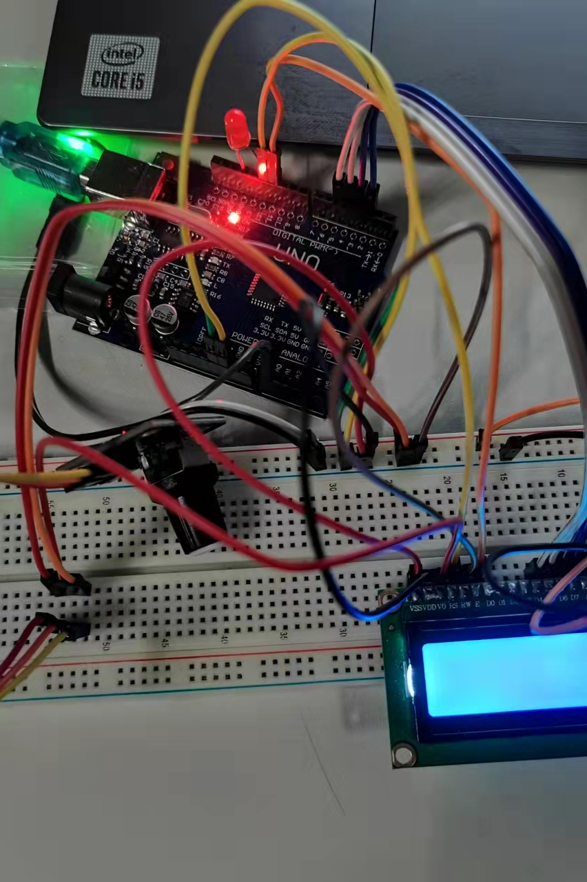
heart rate sensor
Introduction The heart rate sensor reflects the change of heart beat according to the change of blood oxygen saturation in the human body, and can print the heart rate value in real time. This module can switch between digital and analog output modes. When equipped with a display, it can intuitively display the real-time blood oxygen waveform and heart rate value. This product has small size and simple wiring. It can be used directly on the Arduino analog port. It is an essential small module when you DIY.

Slide 3
Arduino UNO
Heart rate sensor
Several wires
Rotary potentiometer
LCD1602A Sheild x1
Bread board

Slide 4
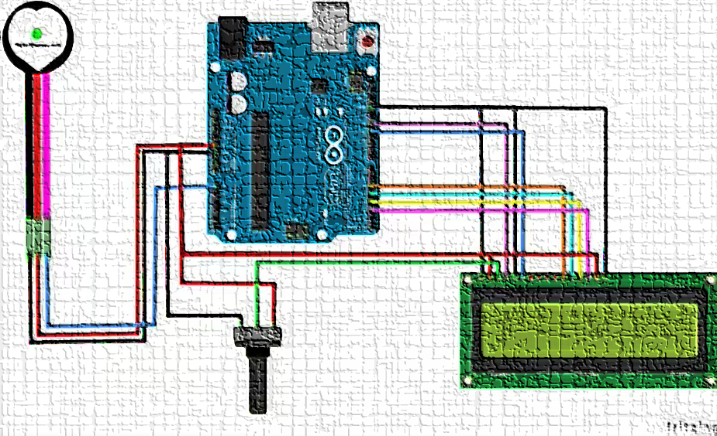
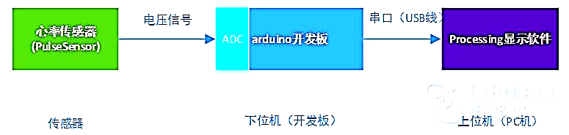
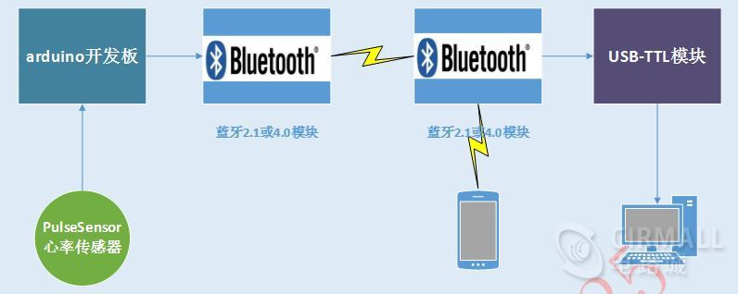
Start
Handling related events
Data acquisition
Signal processing and heart rate calulation
Store date
LCD dispiay
Data differential operation and filtering
Heart rate calculated by median algorithm
End
有线连接方式
无线连接方式

Slide 5
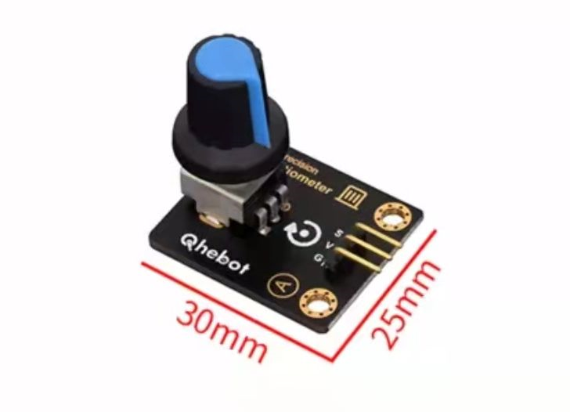
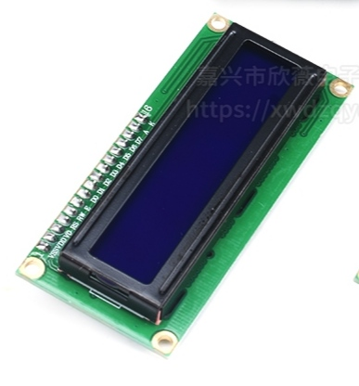
Item | Reference value
Working voltage | 3.3V~5.5V
Operating temperature | -40°C~85°C
Output signal | analog signal
Resistance range | 0~10KΩ
Interface | 2.54 Pin*3P
Piatform | Arduino,microbit,monolithic
Item | Reference value
Logic operating voltage(VDD) | +4.8~+5.2V
Drive voltage (VDD VO) | +3.0~+5.0V
Operating temperature(TA) | -20~+70°C(wide temperature)
Storage temperature(TSTO) | -30~+80°C(wide temperature)
Operating current(except backlight) | 1.7mA(max)
Operating current (backlight) | 24.0mA(max)

Slide 6
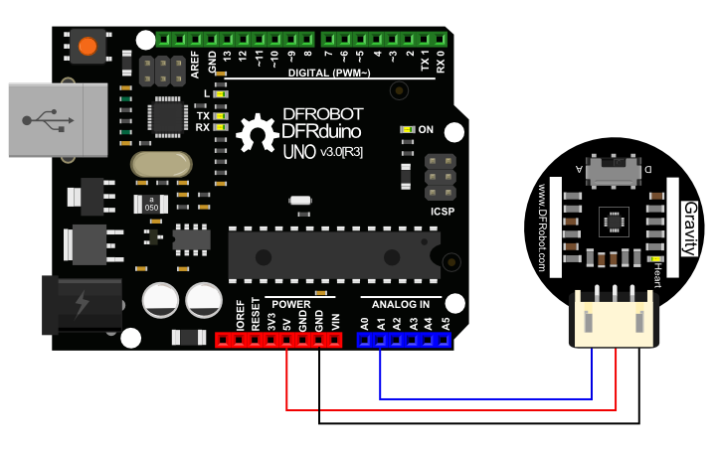
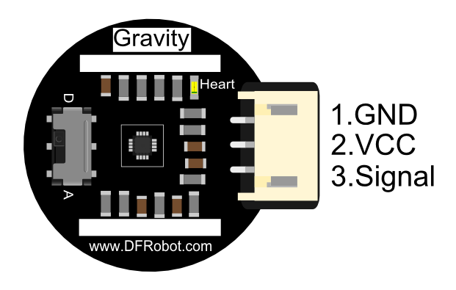
The sensor used test heart rate and pulse waveform is suitable for students, athletes, developers, game or sports terminal developers,and can develop interactive products related to heart rate!
Function type | Numerical value
Working voltage | 3.3v/5vdc
Output signal type | analog signal
Output signal size | 0~3.3v(3.3v power supply) 105v (5v power supply)
Current | 4mA(under 5V)
Led peak wavelength | 515nm
Thickness of circuit board | 1.6mm(thickness of ordinary PCBboard)
Circuit board diameter | 16mm

Slide 7
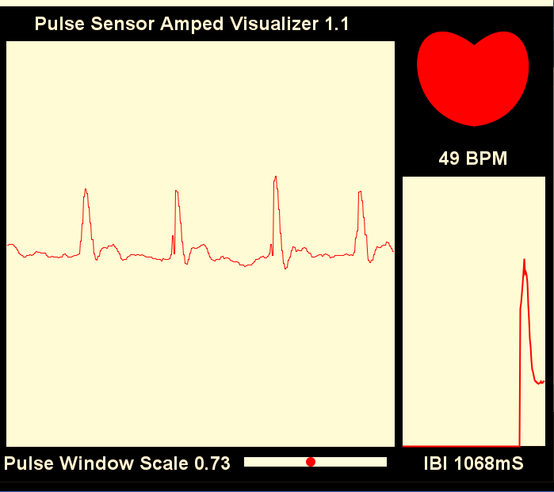
Item | Numerical value | Data
Heart rate | 49 | 2021/12/02
Heart rate | 52 | 2021/12/04
Heart rate | 55 | 2021/12/06
Heart rate | 48 | 2021/12/06
Heart rate | 54 | 2021/12/07
Heart rate | 52 | 2021/12/09
Heart rate | 50 | 2021/12/10
Heart rate | 49 | 2021/12/12

Slide 8
#include <LiquidCrystal.h> const int rs = 12, en = 11, d4 = 5, d5 = 4, d6 = 3, d7 = 2; LiquidCrystal lcd(12, 11, 5, 4, 3, 2); int pulsePin = A0; int blinkPin = 13; //引脚在每次节拍时闪烁 volatile int BPM; // int that holds raw Analog in 0. updated every 2mS volatile int Signal; // holds the incoming raw data volatile int IBI = 600; // int that holds the time interval between beats! Must be seeded! volatile boolean Pulse = false; // "True" when User&apos;s live heartbeat is detected. "False" when not a "live beat". volatile boolean QS = false; // becomes true when Arduoino finds a beat.
static boolean serialVisual = true; // Set to &apos;false&apos; by Default. Re-set to &apos;true&apos; to see Arduino Serial Monitor ASCII Visual Pulse volatile int rate[10]; // array to hold last ten IBI values volatile unsigned long sampleCounter = 0; // used to determine pulse timing volatile unsigned long lastBeatTime = 0; // used to find IBI volatile int P = 512; // used to find peak in pulse wave, seeded volatile int T = 512; // used to find trough in pulse wave, seeded volatile int thresh = 525; // used to find instant moment of heart beat, seeded volatile int amp = 100; // used to hold amplitude of pulse waveform, seeded volatile boolean firstBeat = true; // used to seed rate array so we startup with reasonable BPM volatile boolean secondBeat = false; // used to seed rate array so we startup with reasonable BPM void setup() { pinMode(blinkPin,OUTPUT); // pin that will blink to your heartbeat! Serial.begin(115200); // we agree to talk fast! interruptSetup(); // sets up to read Pulse Sensor signal every 2mS // IF YOU ARE POWERING The Pulse Sensor AT VOLTAGE LESS THAN THE BOARD VOLTAGE, // UN-COMMENT THE NEXT LINE AND APPLY

Slide 9
Conclusion
First of all, it was a great experience for the team members to participate in this practice together. Through the unity and cooperation of the team members, we finally completed the basic requirements of the topic. This practice also improved our practical ability to analyze and solve problems. The most important thing is to enhance our team cooperation awareness, innovation ability and ability to live in harmony, Let us truly realize that theory is applied to practice and consolidate theoretical knowledge in practice. Especially in the process of practice, when we encounter difficulties, our experience of fighting together for several days and nights has also given us a huge precious wealth in the process of growth, which we will cherish.

Slide 10
Thanks for watching

